Slide 1
Introduction to Data Structure and Algorithms

Slide 2
Data Structures

Slide 3
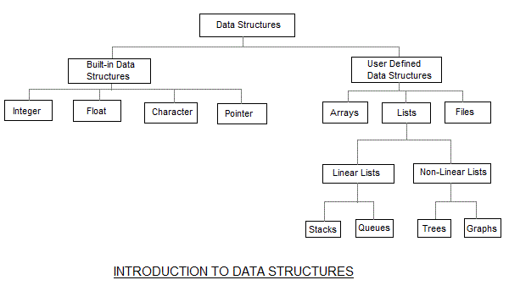
What is it
Data structure is a method of organizing large amount of data more efficiently

Slide 4
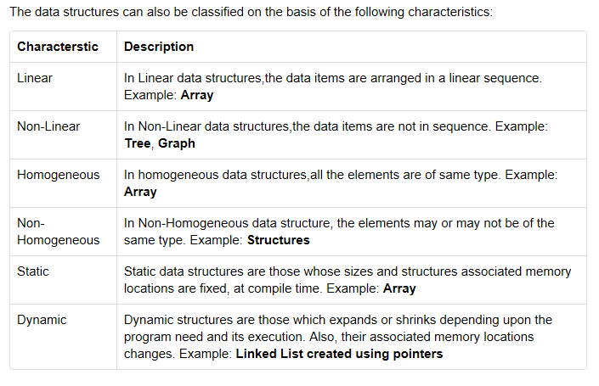

Slide 5
Based on the organizing method of a data structure, data structures are divided into two types.
Linear Data Structures
  Arrays
  List (Linked List)
  Stack
  Queue
Non - Linear Data Structures
  Tree
  Graph
  Dictionaries
  Heaps

Slide 6
Introduction to Algorithms
What is an Algorithm
Steps in Designing and Implementing an Algorithm
Important Problem Types

Slide 7
ALGORITHM
A sequence of unambiguous instructions for solving a problem, i.e. for obtaining the required output for any legitimate input in a finite amount of time

Slide 8
What is an algorithm?
An algorithm is a sequence of unambiguous instructions for solving a problem, i.e., for obtaining a required output for any legitimate input in a finite amount of time.
problem
algorithm
“computer”
input
output

Slide 9
Algorithm
Characteristics of good algorithm
Unambiguity/clearness
Precise/definite
Effectiveness
Finiteness/termination
Correctness

Slide 10
Properties of an Algorithm
Effectiveness
  All operations to be performed must be sufficiently basic that they can be done exactly and in finite length.
Definiteness
  The steps in the algorithm must be clearly defined and detailed
Correctness
  give the right answer for all possible cases
Finiteness
  The algorithm must come to an end in a reasonable time

Slide 11
Notion of algorithm and problem
problem
algorithm
“computer”
input
(or instance)
output
algorithmic solution
(different from a conventional solution)

Slide 12
Understand the problem
Decide on computational means
Exact vs approximate solution
Data structures
Algorithm design technique
Design an algorithm
Prove correctness
Analyze the algorithm
Code the algorithm

Slide 13
Euclid’s Algorithm
Problem: Find gcd(m,n), the greatest common divisor of two nonnegative, not both zero integers m and n
Examples: gcd(60,24) = 12, gcd(60,0) = 60, gcd(0,0) = ?
Euclid’s algorithm is based on repeated application of equality
gcd(m,n) = gcd(n, m mod n)
until the second number becomes 0, which makes the problem
trivial.
Example: gcd(60,24) = gcd(24,12) = gcd(12,0) = 12
Notes:
Euclid’s algorithm is good for introducing the notion of an algorithm because it
makes a clear separation from a program that implements the algorithm.
It is also one that is familiar to most students.
Al Khowarizmi (many spellings possible...) – “algorism” (originally) and then
later “algorithm” come from his name.

Slide 14
Two descriptions of Euclid’s algorithm
Step 1 If n = 0, return m and stop; otherwise go to Step 2
Step 2 Divide m by n and assign the value of the remainder to r
Step 3 Assign the value of n to m and the value of r to n. Go to
Step 1.
while n ≠ 0 do
r ← m mod n
m← n
n ← r
return m

Slide 15
Other methods for computing gcd(m,n)
Consecutive integer checking algorithm
Step 1 Assign the value of min{m,n} to t
Step 2 Divide m by t. If the remainder is 0, go to Step 3;
otherwise, go to Step 4
Step 3 Divide n by t. If the remainder is 0, return t and stop;
otherwise, go to Step 4
Step 4 Decrease t by 1 and go to Step 2
Is this slower than Euclid’s algorithm? How much slower?
O(n), if n <= m , vs O(log n)

Slide 16
Other methods for gcd(m,n) [cont.]
Middle-school procedure
Step 1 Find the prime factorization of m
Step 2 Find the prime factorization of n
Step 3 Find all the common prime factors
Step 4 Compute the product of all the common prime factors
and return it as gcd(m,n)
Is this an algorithm?
How efficient is it?
Time complexity: O(sqrt(n))

Slide 17
Stages of Algorithm development
Describing the Problem
Identifying Suitable technique
Design of an algorithm
Proof of Correctness of an algorithm
Computing the time complexity

Slide 18
Describing the Problem
Define the problem clearly
Ex. Sorting Problem
Matrix manipulations
Shortest path problem etc

Slide 19
Identifying Suitable technique
Find the efficient technique to solve the problem.
For every problem there is always more than one technique to solve it.
Need to decide the algorithm paradigm to be used to solve a problem
Ex: To perform matrix multiplication whether to perform divide and conquer or dynamic programming technique.
For sorting problems : Brute force or divide and conquer techniques
Need to analyse and identify the best algorithm to solve the given problem which takes less time and occupies least memory space.

Slide 20
Design of an Algorithm
Algorithm must be free from ambiguity
Must focus on problem rather than syntactical considerations
Must be efficient

Slide 21
Algorithm for Insertion sort
INSERTION-SORT A[1…….n]
1. for j = 2 to length(A)
2. key ← A [j]
3. // Insert A[j] into the sorted sequence A[1..j-1]
4. j ← i – 1
5. while i > 0 and A[i] > key
6. A[i+1] ← A[i]
7. i ← i – 1
8. A[j+1] ← key

Slide 22
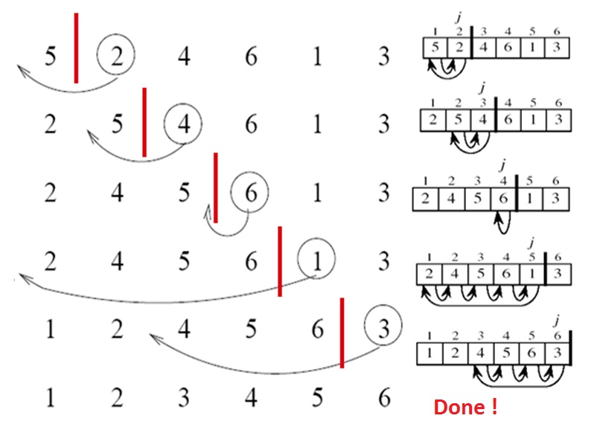
Let us take one example and see the Operations of Insertion Sort on the given Array. A= { 5 , 2, 4, 6, 1, 3}

